Slide 1
Corda Concepts
Concept to Code

Slide 2
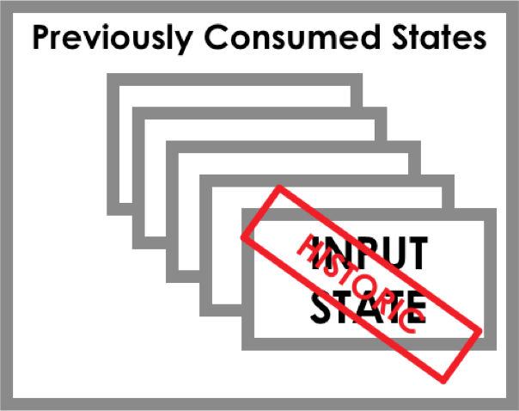
Concepts to Code
Corda: Key Concepts
NOTARY
IOU CONTRACT REF
IOU STATE PROPERTIES
From: Alice
To: Bob
Amount: £10
Due: 01/03/2017
Paid: £5
Penalty: 20%
OUTPUT STATE
ALICE
PARTICIPANTS
Alice Bob
INPUT STATE
State Object
States are immutable objects that represent (shared) facts such as a financial agreement or contract at a specific point in time
Transaction
Transactions consume input states and create output states.
The newly created output states replace the input states which are marked as historic.
Consensus
Parties reach consensus on the evolution of a shared fact. This is done by testing the validity (by way of contract code) and uniqueness (by way of the notary) of the transaction.
Flows
BOB
Flows are light-weight processes used to coordinate interactions required for peers to reach consensus about shared facts.
2

Slide 3
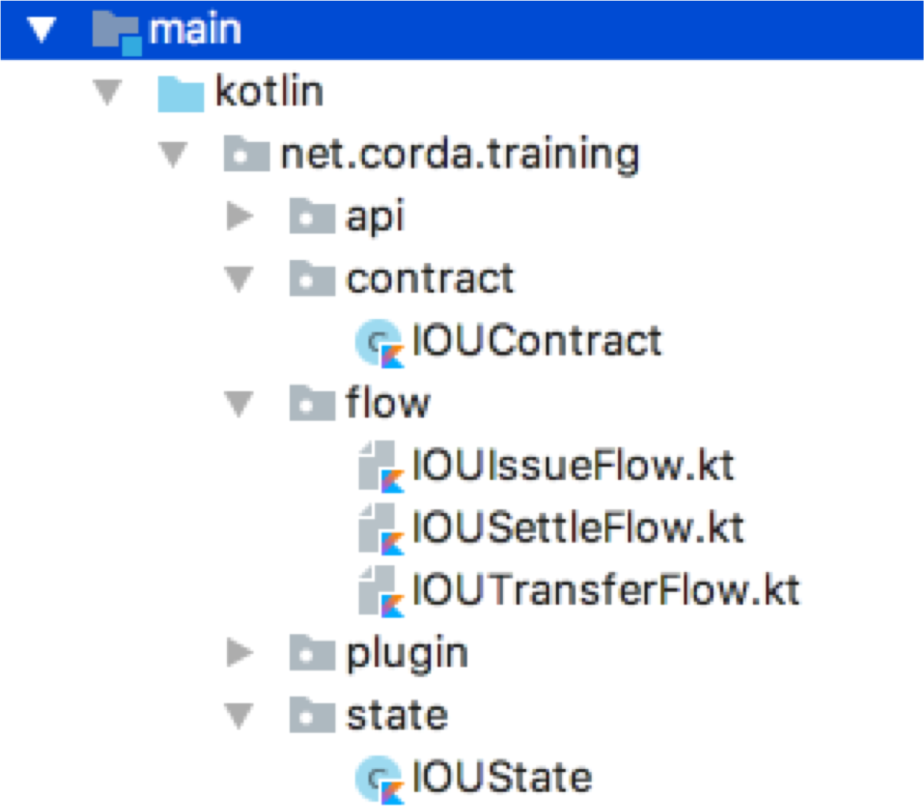
Concepts to Code
CODE
Contract
Flow
State

Slide 4
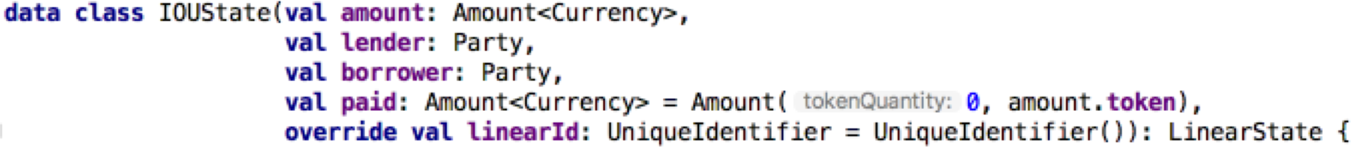
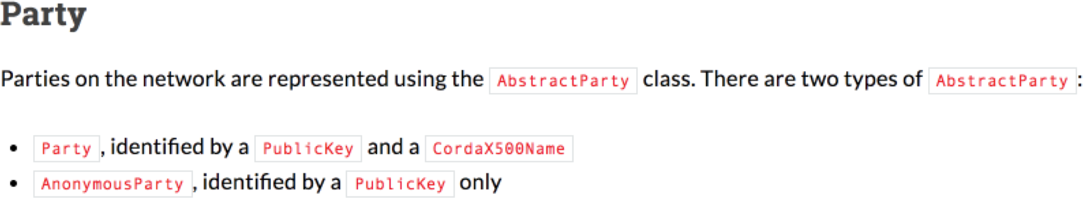
Concept to Code
State
Asset/Object Attributes
Participants

Slide 5
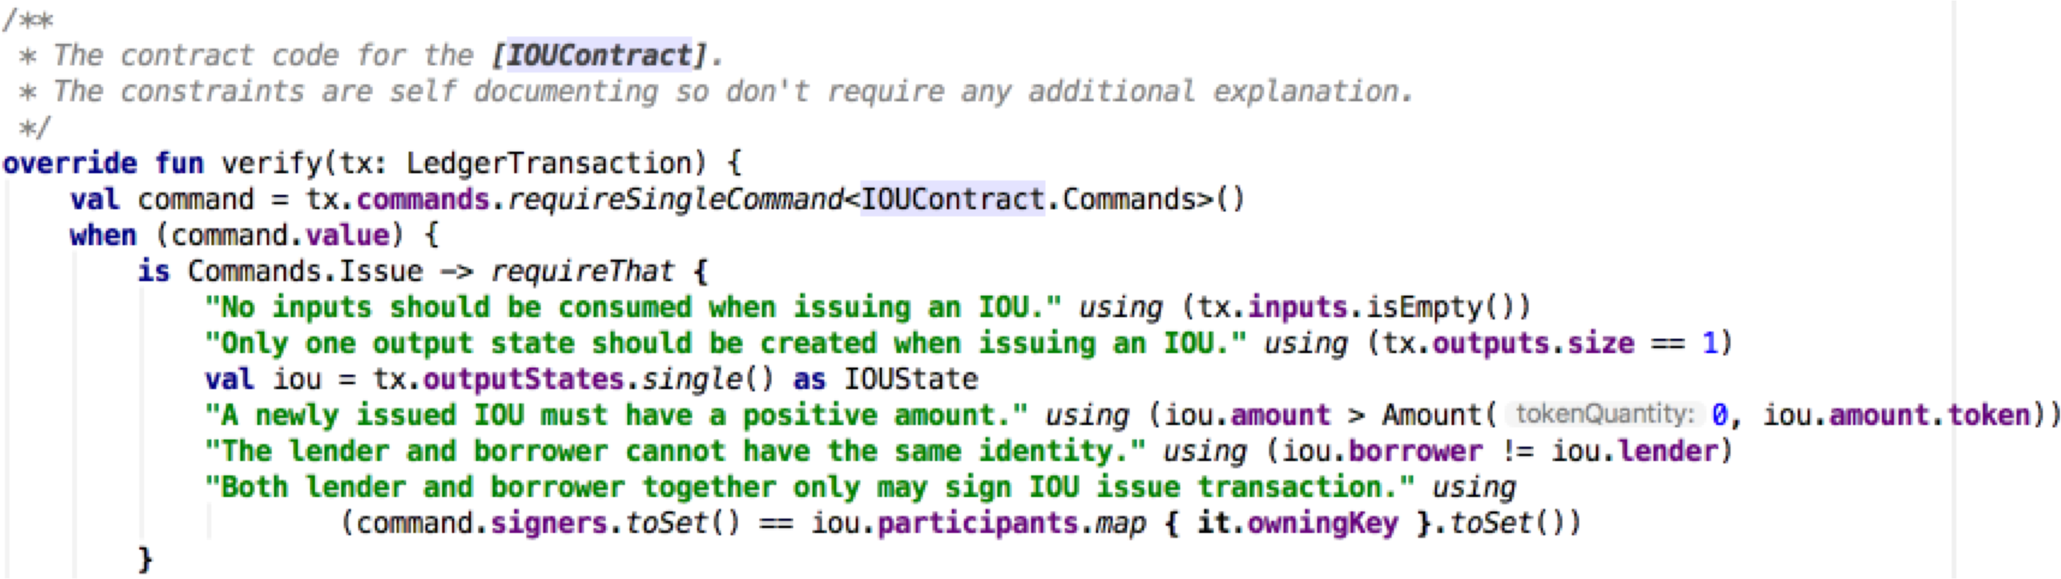
Concept to Code
Contract
deterministic Command logic

Slide 6
Concept to Code
Flow
Build Transaction
Verify & Sign
Gather Signatures
Finalize Transaction

Slide 7
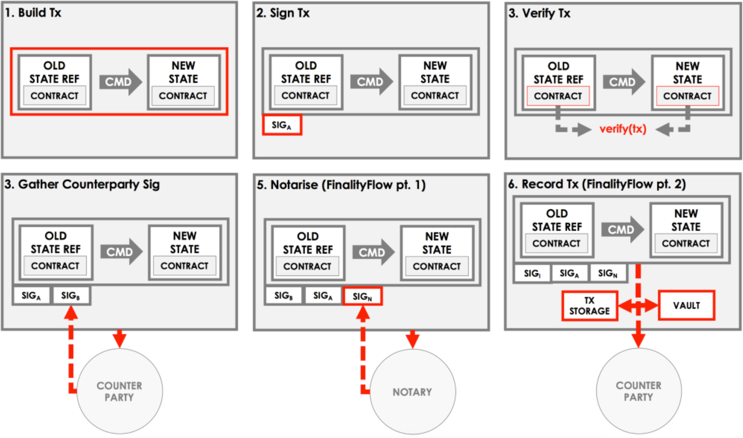
Flow Steps - Visual

